Slide 1
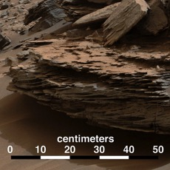
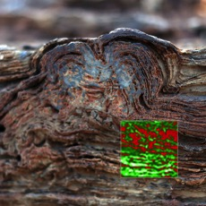
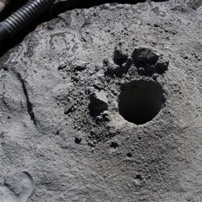
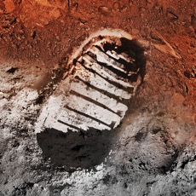
Mars 2020 Mission Objectives
SEEKING ANCIENT MICROBIAL LIFE
GEOLOGIC EXPLORATION
Explore an ancient environment on Mars
Understand processes of formation and alteration
HABITABILITY AND
BIOSIGNATURES
Assess habitability of ancient environment
Seek evidence of past life
Select sampling locations with high biosignature preservation potential
PREPARE A RETURNABLE CACHE
Capability to collect ~40 samples and blanks, 20 in prime mission
Include geologic diversity
Deposit samples on the surface for possible return
PREPARE FOR HUMAN EXPLORATION
Measure temperature, humidity, wind, and dust environment
Demonstrate In Situ Resource Utilization by converting atmospheric CO₂ to O₂
Notes:
To understand the possibilities for life on Mars, we seek to fulfill four ambitious Objectives
GEOLOGY: Objective A is to “Carry out an integrated set of context, contact, and spatially-coordinated measurements to characterize the geology of the landing site”
The landing site – no matter which one is picked – is studied in great detail from orbit, which is how we know it’s a great place to study. The rover will take the next step and study it in various scales: the immediate neighborhood, the terrain, its various rock formations, and down to the microscopic level
Study rocks and soil at various scales down to the microscopic level
Understand how and why they formed
Reveal the landing site’s history and origins
ASTROBIOLOGY: Objective B pertains to in situ Astrobiology: Find and characterize ancient habitable environments, identify rocks with the highest chance of preserving signs of ancient Martian life if it were present, and within those environments, seek the signs of life
Find an area that would have been been most likely to harbor life.
Study the rocks and soil there to look for the telltale “fingerprints” of ancient life
SAMPLE RETURN: Place rigorously documented and selected samples in a returnable sample cache for possible future return to Earth
Take samples of Mars rocks and soil
Store them on the surface for potential future return to Earth
PREPARE FOR HUMAN EXPORATION: Demonstrate technology for future human exploration. Characterize atmospheric dust size and shape to understands its effects on the operation of surface systems and human health. Measure surface weather to validate global atmospheric models.
Show that we can generate propellant and consumable oxygen from the Martian atmosphere for future exploration missions.
Study Mars weather, dust and its effect on human health

Slide 2
Mars 2020 Mission Overview
LAUNCH
Atlas V 541 vehicle
Launch Readiness Date: July 2020
Launch window: July/August 2020
CRUISE/APPROACH
~7 month cruise
Arrive Feb 2021
ENTRY, DESCENT & LANDING
MSL EDL system (Range Trigger and Terrain Relative Navigation): guided entry and powered descent/Sky Crane
16 x 14 km landing ellipse (range trigger baselined)
Access to landing sites ±30° latitude, ≤ -0.5 km elevation
Curiosity-class Rover
SURFACE MISSION
20 km traverse distance capability
Enhanced surface productivity
Qualified to 1.5 Martian year lifetime
Seeking signs of past life
Returnable cache of samples
Prepare for human exploration of Mars
https://mars.nasa.gov/mars2020/

Slide 3
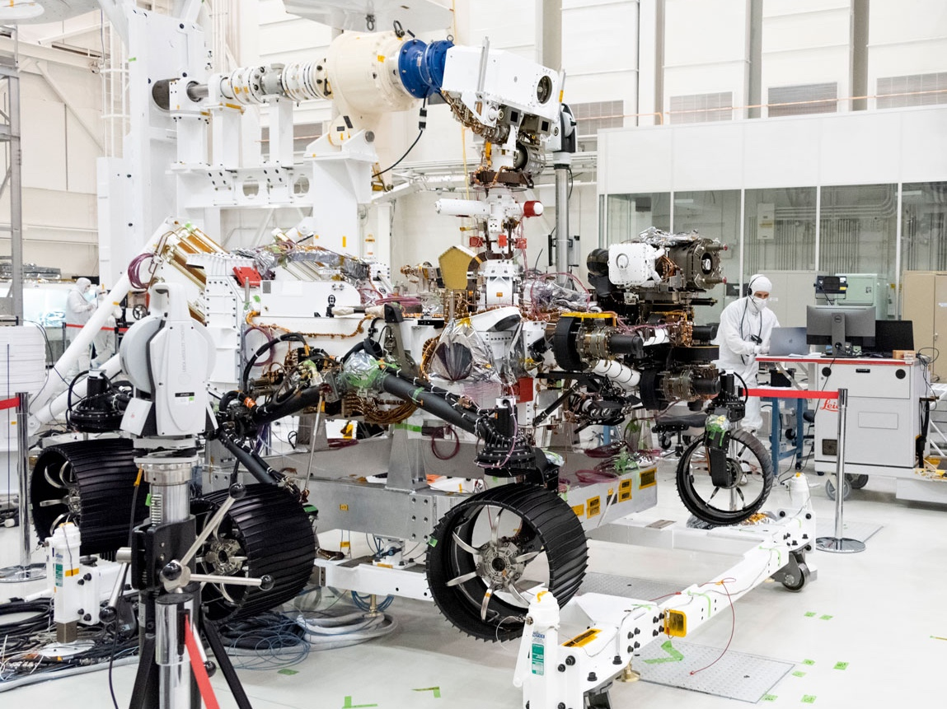
Notes:
SUPERCAM
It is located on the rover’s “head”
It examines rocks and soils with a camera
It is located on the rover’s mast, and can zoom in to interesting targets. It helps out other Mars 2020 experiments by looking at the whole landscape, and identifying rocks and "soil" (regolith) for a closer look by the rover's other instruments.
"SuperCam" is a superhero for making discoveries on Mars! Its cameras have super vision, and its spectrometers have super senses for identifying the chemical makeup of Martian rocks and "soil" (regolith).
SuperCam can see across great distances to measure targets not reachable by the rover's other tools. It's an improved version of the ChemCam laser on Mars rover Curiosity: SuperCam can additionally analyze minerals and molecules, and take color instead of only black-and-white pictures.
SuperCam also measures the air and dust hazards
MEDA measures wind speed and direction, temperature and humidity, even the amount and size of dust particles in the atmosphere

Slide 4
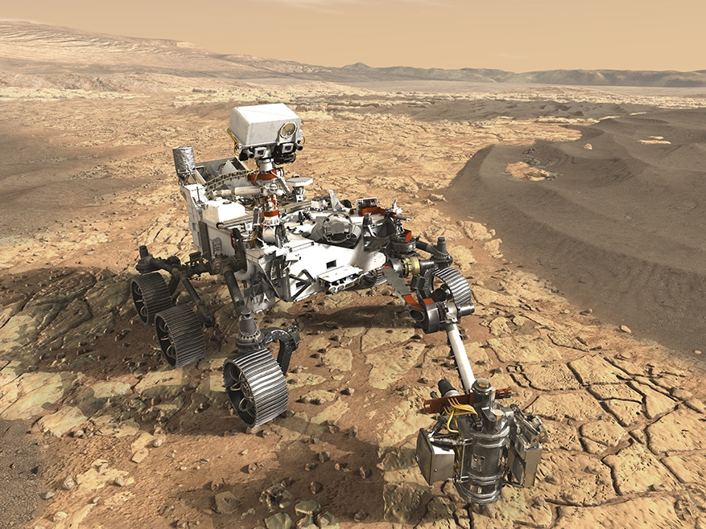
Spanish Contributions to Mars 2020
SUPERCAM CALIBRATION TARGET
Enabling the SuperCam instrument to investigate chemical compositions of Martian rocks and soils from a distance
HIGH GAIN ANTENNA
Steerable X-Band antenna enabling data transmission directly to and from Earth
MEDA
The rover’s weather station, to measure temperature, wind speed, and other meteorological factors.
Notes:
SUPERCAM
It is located on the rover’s “head”
It examines rocks and soils with a camera
It is located on the rover’s mast, and can zoom in to interesting targets. It helps out other Mars 2020 experiments by looking at the whole landscape, and identifying rocks and "soil" (regolith) for a closer look by the rover's other instruments.
"SuperCam" is a superhero for making discoveries on Mars! Its cameras have super vision, and its spectrometers have super senses for identifying the chemical makeup of Martian rocks and "soil" (regolith).
SuperCam can see across great distances to measure targets not reachable by the rover's other tools. It's an improved version of the ChemCam laser on Mars rover Curiosity: SuperCam can additionally analyze minerals and molecules, and take color instead of only black-and-white pictures.
SuperCam also measures the air and dust hazards
MEDA measures wind speed and direction, temperature and humidity, even the amount and size of dust particles in the atmosphere

